Slide 1
#team_project_plan
“Theft Prevention System”
Team 4-3
201636417 심우석
201932112 김주은
201932119 박나운
201932135 이다영

Slide 2

A table of Contents
#1,
Motivation & Goal
#2,
Value of our proposed system
#3,
Hardware components and their role
#4,
Special points of our proposed system
#5, Progress
#6, Participation of each team member

Slide 3

Part 1,
Motivation & Goal

Slide 4
Part 1
Motivation & Goal
piezo speakers
ultrasonic sensors
light sensors
We selected theft prevention system as the project theme to create works that can protect objects at risk of theft.
Using ultrasonic sensors, light sensors, and piezo speakers, we plans to create works to detect movement and prevent theft of objects.

Slide 5

Value of our proposed system
Part 2,

Slide 6
Part 2
Value of our proposed system
Related work
Practical aspects
Creative aspects
Design and Implementation of smart bicycle stolen alarm using Arduino
-Korea IT Marketing Association
Designing a Remote Controlled IOT- Based Anti-Theft System
– Korean Society for Knowledge
Information Technology
It is a system that does not require manpower at all times, enabling efficient operation with fewer people.
Sensitive to small movements with various sensors, the risk of theft is very low.
The location of the object is recorded through ultrasonic sensors and recognized as theft when there is a change.
Light sensor is also utilized for dual security. Brightness changes occur even in very small movements, enabling more accurate security.

Slide 7

Part 3,
Hardware components and their role

Slide 8
Part 3
Hardware components and their role
Button
Start/stop the detection system and stop the burglar alarm by pressing a button with a set pattern.
RGB LED
Illumination to indicate that the sensing system is operating
Light sensor
Detects changes in
brightness caused by
movement of objects during
constant brightness
Piezo speaker
A warning buzzer that rings when all the theft conditions are met.
Ultrasound sensor
Ultrasonic sensors monitor the condition of an object and detect changes in position caused by
movement.
LCD
Outputs system status. (System start/stop,
theft/stop, etc.)

Slide 9

Part 4,
Special points of our proposed system

Slide 10
Part 4
Special points of our proposed system
Pros
&
Cons
Advantage : Fine motion detection is possible.
Flexible operation is possible through
various pin numbers.
Weakness : All sensors stop when pin numbers are
exposed, as this can only be adjusted
with pin numbers
Special
points
To be stressed
Installing the sensor from multiple surfaces ⇒ Detect all directions
The light sensor records changes in brightness ⇒ Dual security
Installation of pin numbers ⇒ Increased security
Notes:
To prevent the risk of deceiving the sensor by using a substitute, the sensor can be installed from multiple surfaces to detect all directions. The light sensor also records changes in brightness, enabling more detailed detection through dual security. Installation of pin numbers, the only way to terminate warning notifications, further increased security.

Slide 11
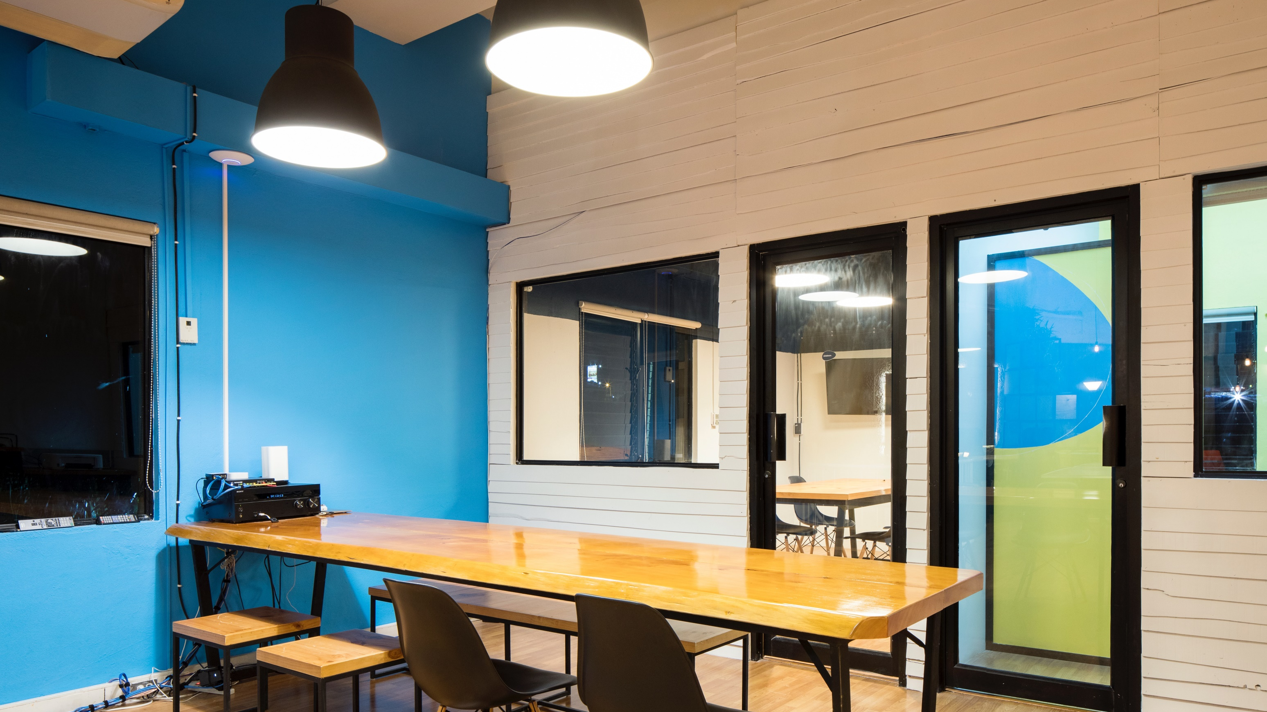
Part 5,
Progress

Slide 12
Part 5
Progress
Ideation
10/24- Collecting ideas through data research
10/25 - Select & Present at least 2 Ideas Each
Select the theme of the "Stolen Prevention System" by voting among them.
Specific Progress Meeting
After determining the overall content, proceed with additional complementary methods to prevent further defects.

Slide 13

Part 6,
Participation of each team member

Slide 14
Part 6
Participation of each team member
심우석
(201636417)
Research, Idea conference, Announcement
김주은
(201932112)
Research, Idea conference, ppt production
박나운
(201932119)
Research, Idea conference, ppt production
이다영
(201932135)
Research, Idea conference, Create structure chart

Slide 15
Thank you☺

